Slide 1
Genesis and Migration

Slide 2
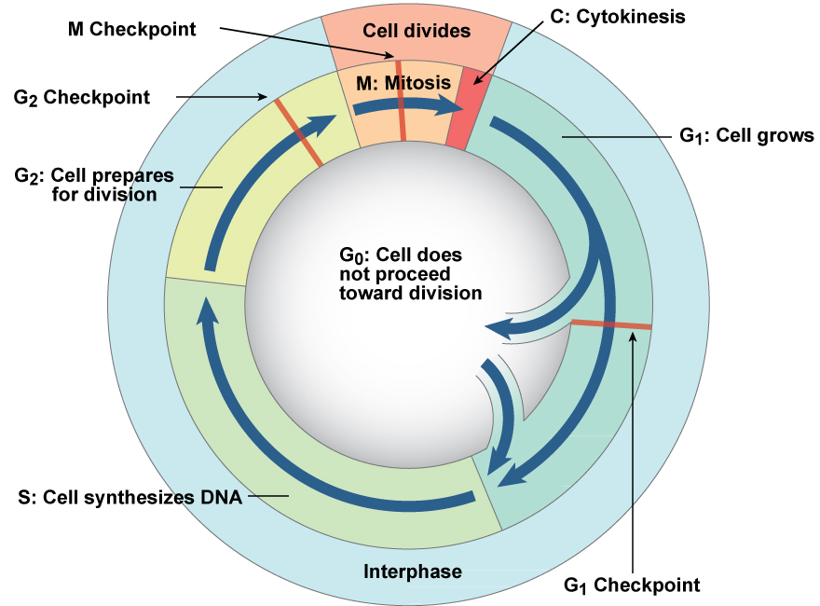
Cell cycle checkpoints
Progression through the cell cycle is controlled by checkpoints. Cells that do not divide do not pass the G₁ checkpoint and remain in G₀. Once a cell passes the G₁ checkpoint, it is usually committed to complete mitosis. Cells with DNA or chromosome damage will fail to pass the G₂ or M checkpoints.

Slide 3
Control of the Cell Cycle
Cell-cycle length can vary greatly among cell types; variation in the length of G₁ phase is responsible for these differences.
  G₁ phase is essentially eliminated in rapidly dividing cells.
  Nondividing cells get permanently stuck in G₁ phase; this arrested stage is called the G₀ state.
The rate of cell division can also respond to changes in environmental conditions.
These variations in cell-cycle length suggest that the cell cycle is regulated and that regulation varies among cells and organisms.

Slide 4
Mitosis-Promoting Factor Induces Mitosis
Mitosis-promoting factor (MPF) is present in the cytoplasm of M-phase cells and induces mitosis in all eukaryotes.
MPF is composed of two distinct subunits: a protein kinase and a cyclin.
  The protein kinase is an enzyme that catalyzes the transfer of a phosphate group from ATP to a target protein (phosphorylation).
  The cyclin subunit functions as a regulatory protein.

Slide 5
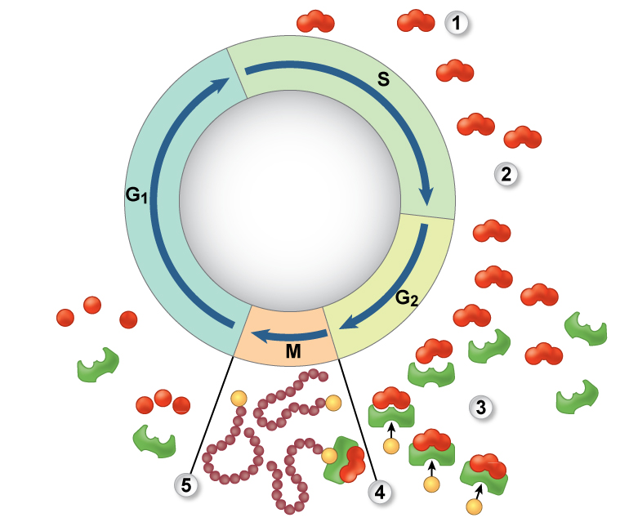
Cyclins
Class of proteins whose concentration depends on cell cycle phase. Cyclins bind to and activate cyclin-dependent kinases (Cdks), which phosphorylate other proteins involved in cell cycle. Maturation-promoting factor (MPF) is a cyclin-Cdk complex that participates in enzyme activation, nuclear envelope breakdown, and chromosome condensation.

Slide 6
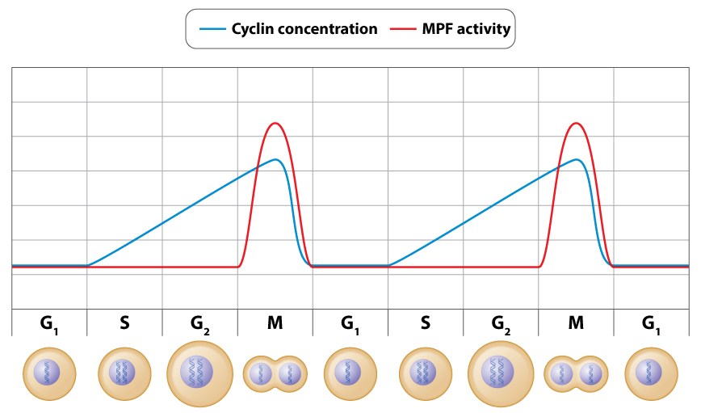
Cyclins and MPF
Cyclin and MPF levels peak at M phase. Cyclin levels rise steadily starting at S phase.

Slide 7
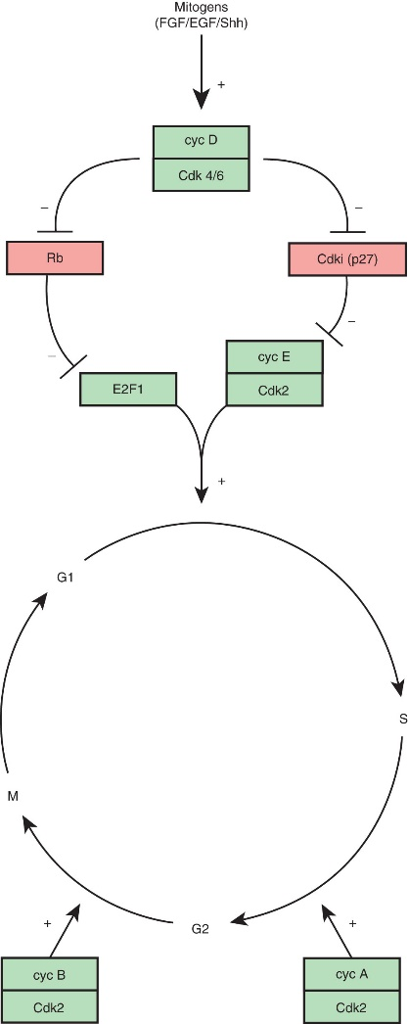
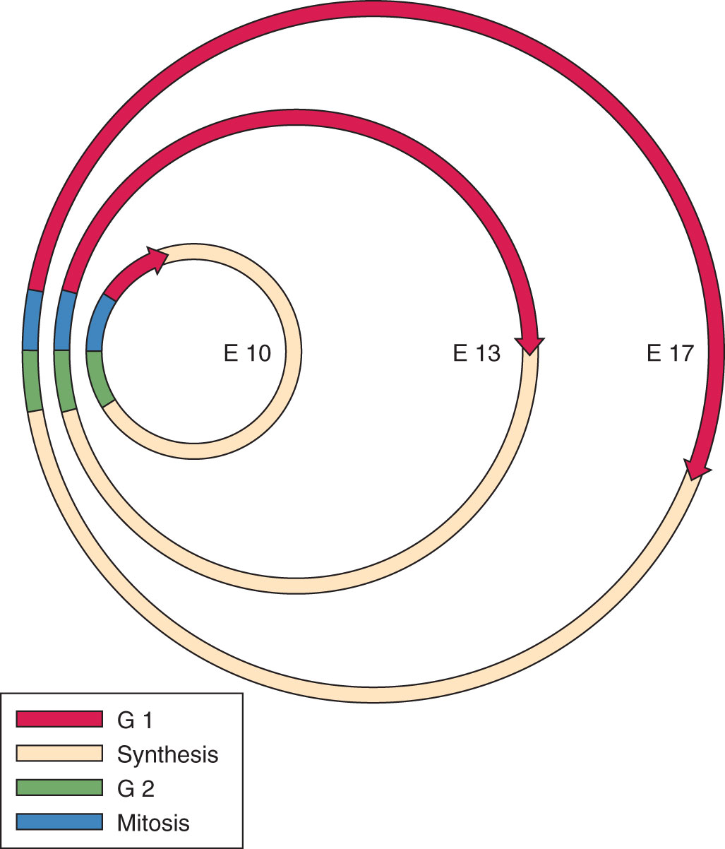
Cell Cycles in NSCs

Slide 8
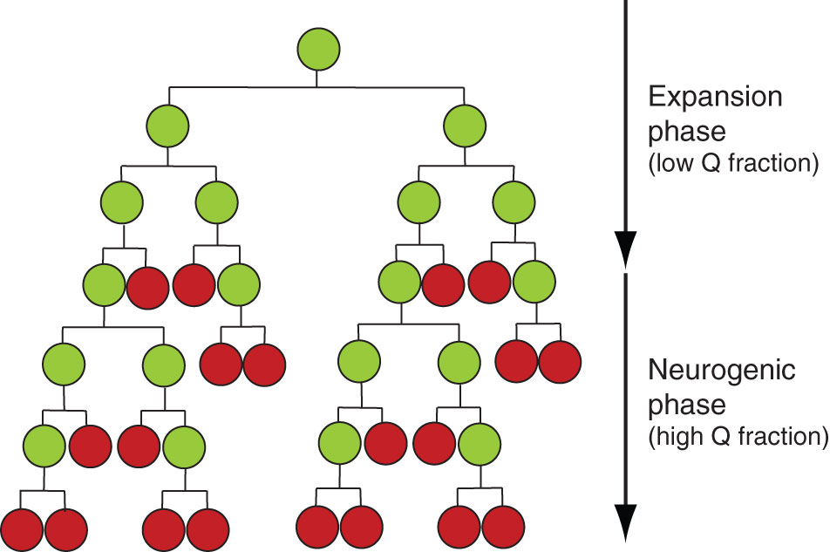
Neurogenesis Proceeds with Cell Cycle Exiting

Slide 9
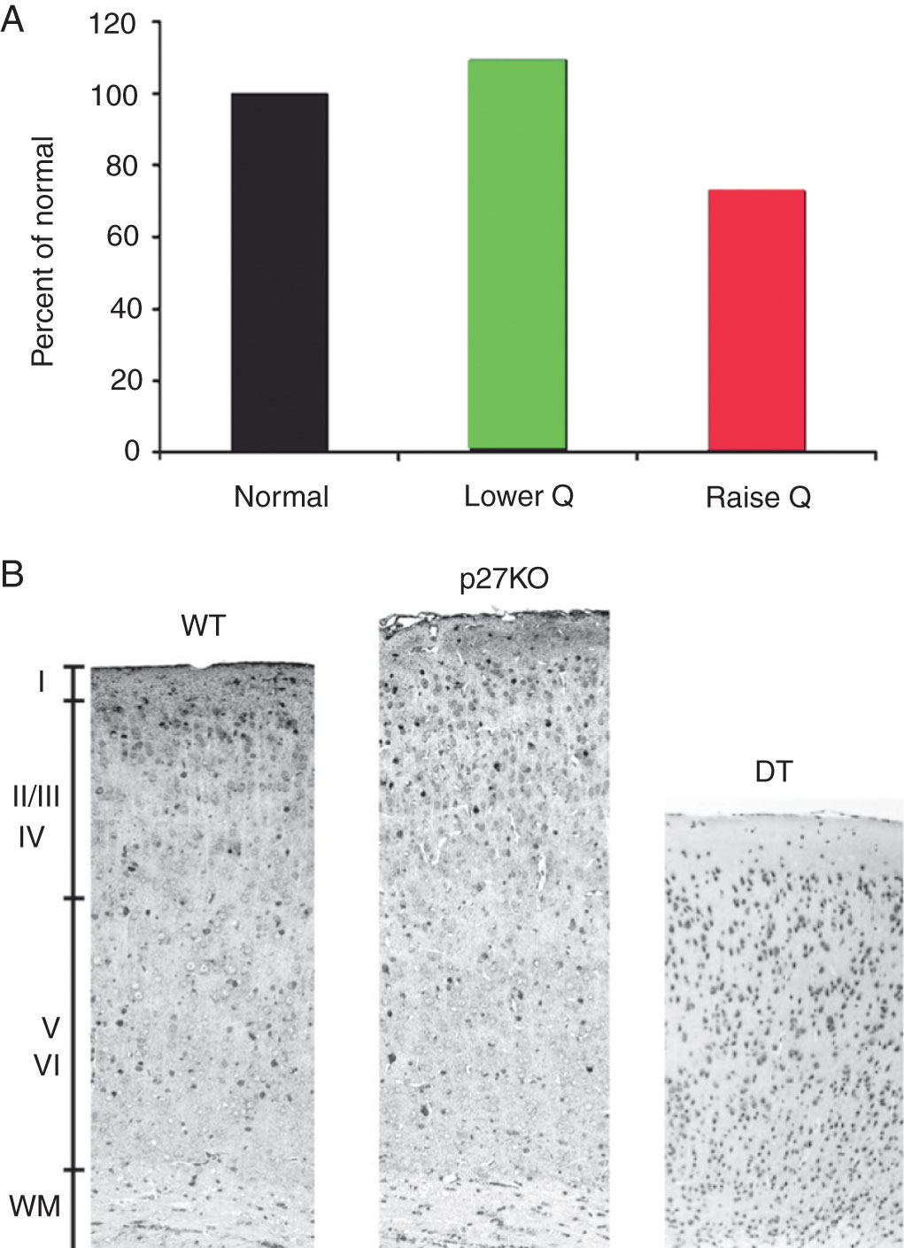
Cell Cycle Exiting is Tightly Controlled in Development

Slide 10
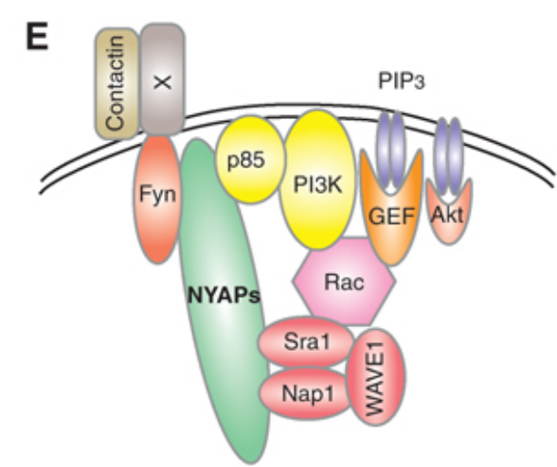
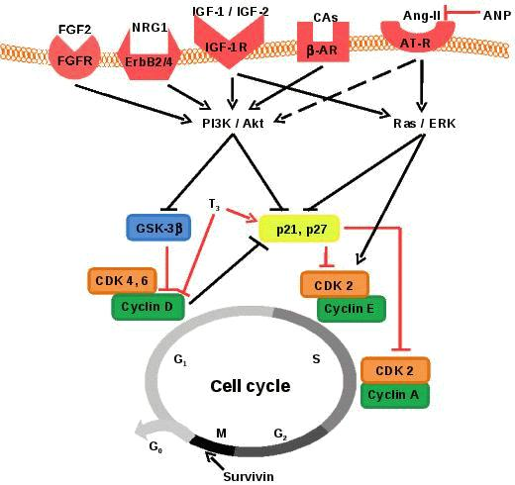
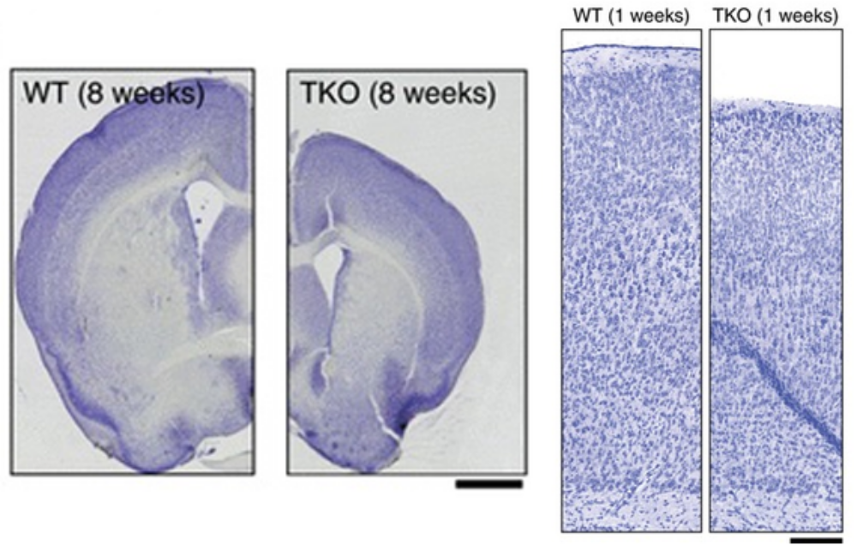
Intracellular Cascades and Cell Cycle Entry

Slide 11
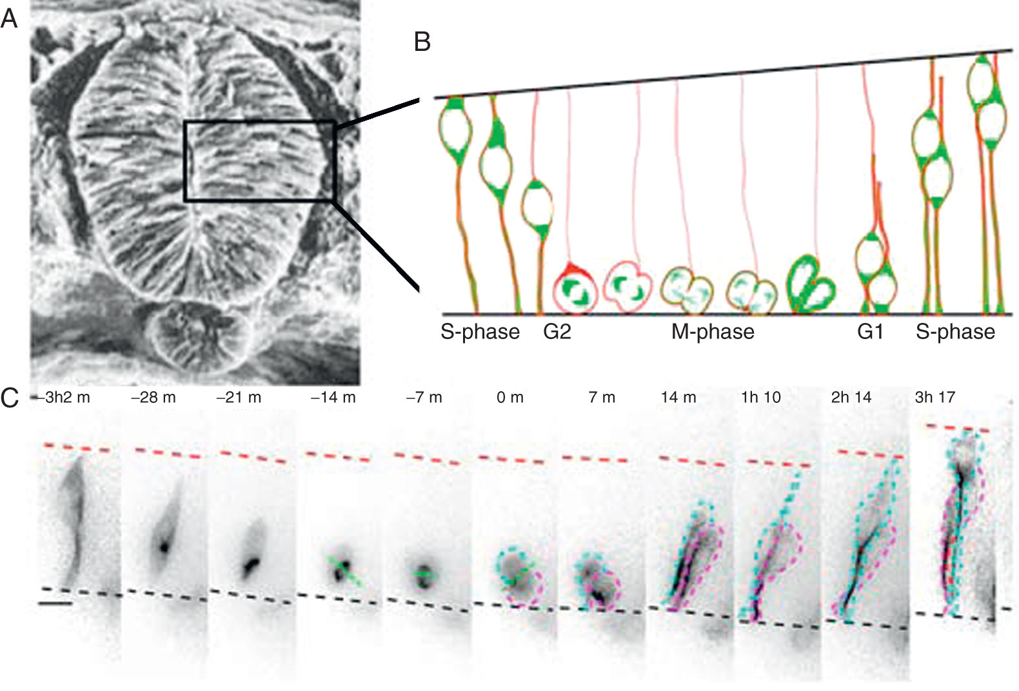
Cell Cycle of Early Neural Stem Cells

Slide 12
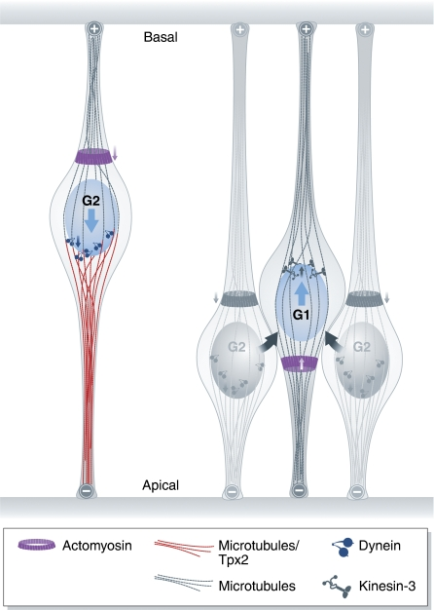
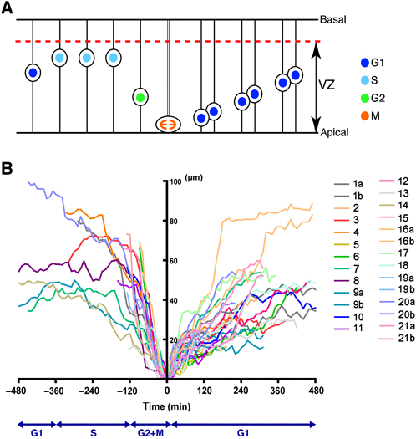
Interkinetic Nuclear Migration

Slide 13
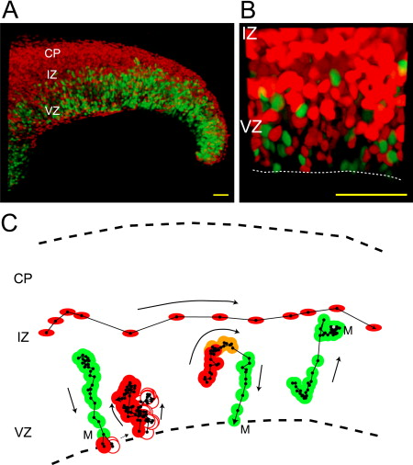
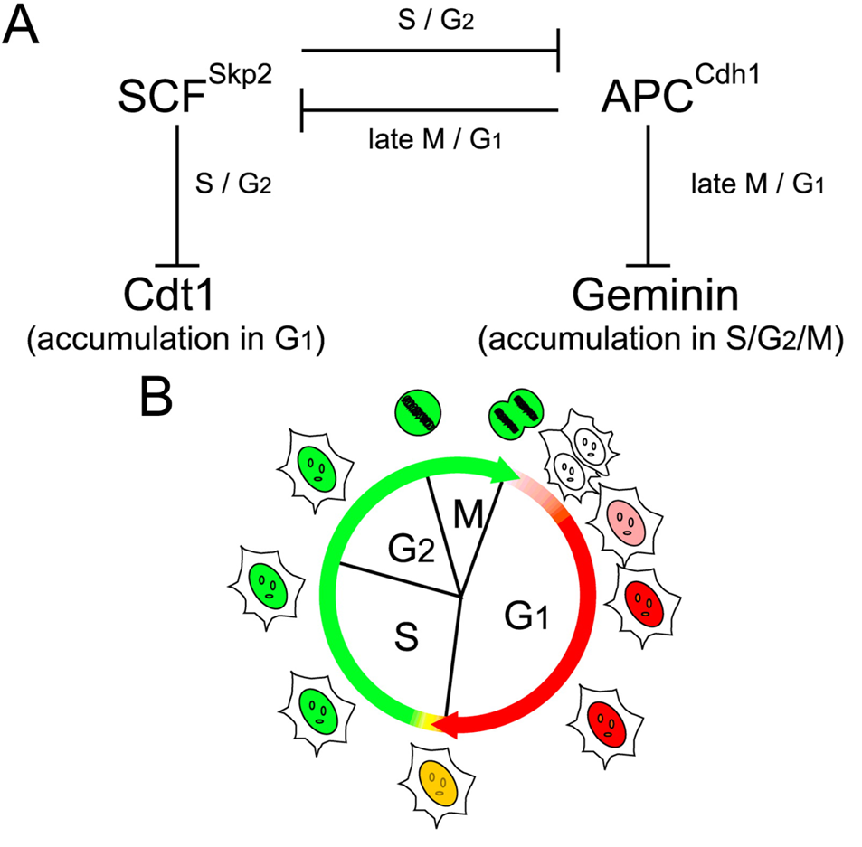
FUCCI Labeling of Cell Cycle Progression

Slide 14
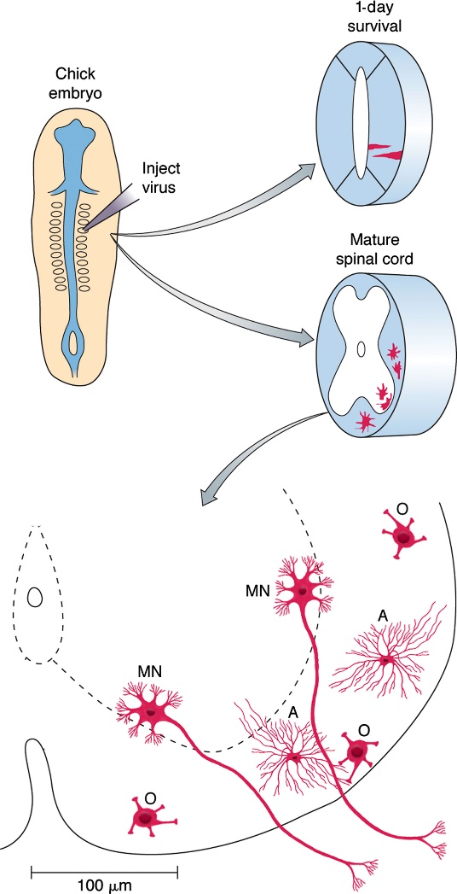
Tracing Neural Stem Cell Lineages

Slide 15
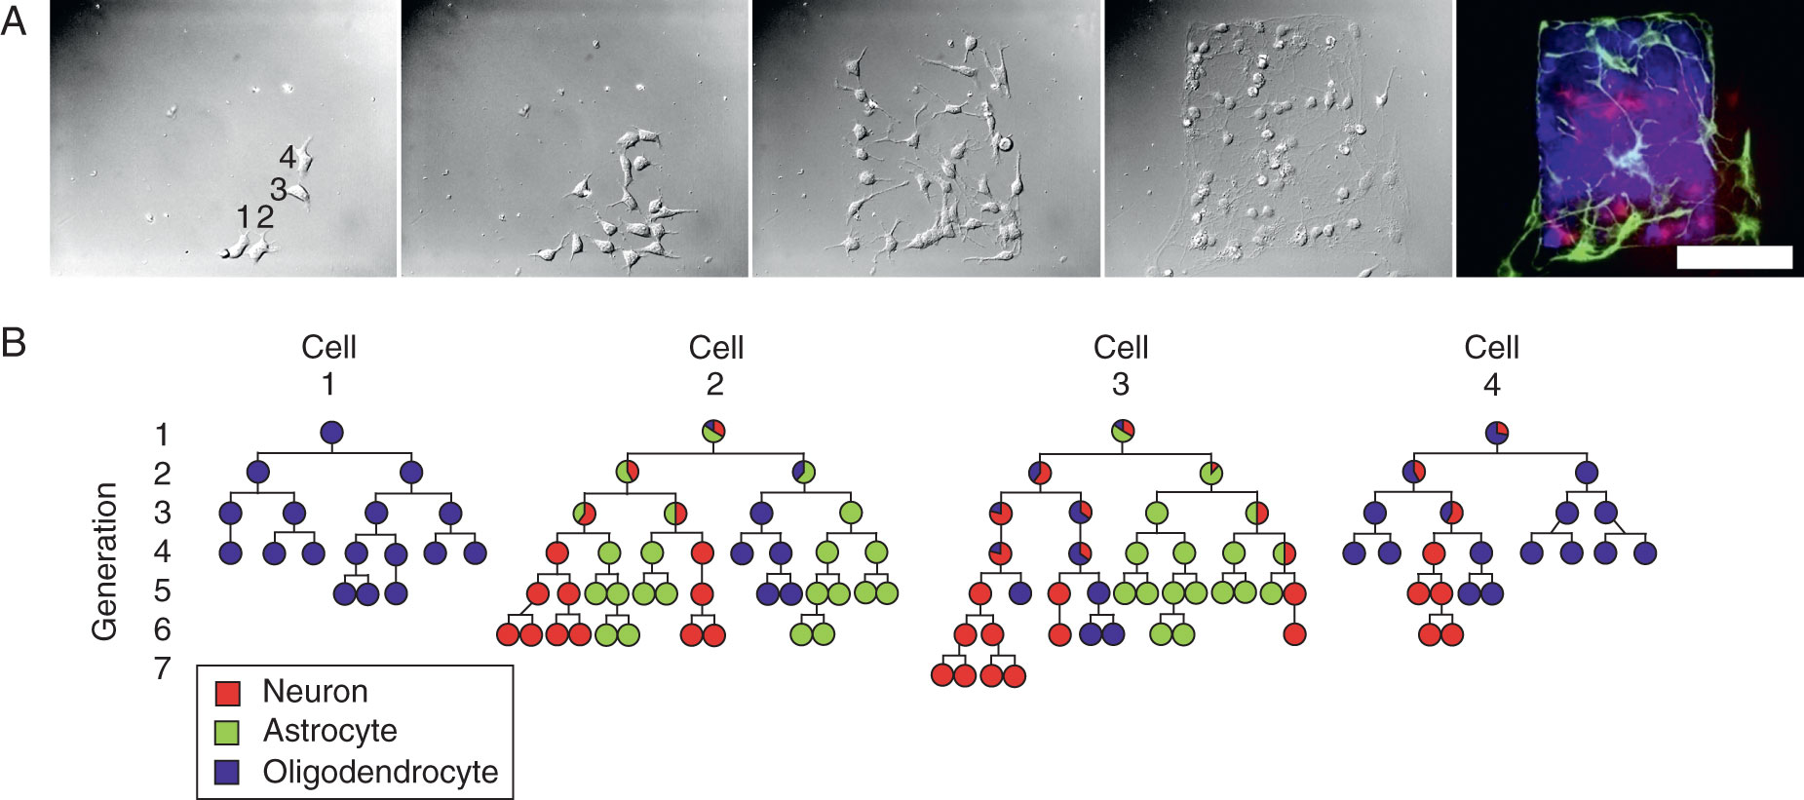
Can different stem cells give rise to neurons rather than glia?

Slide 16
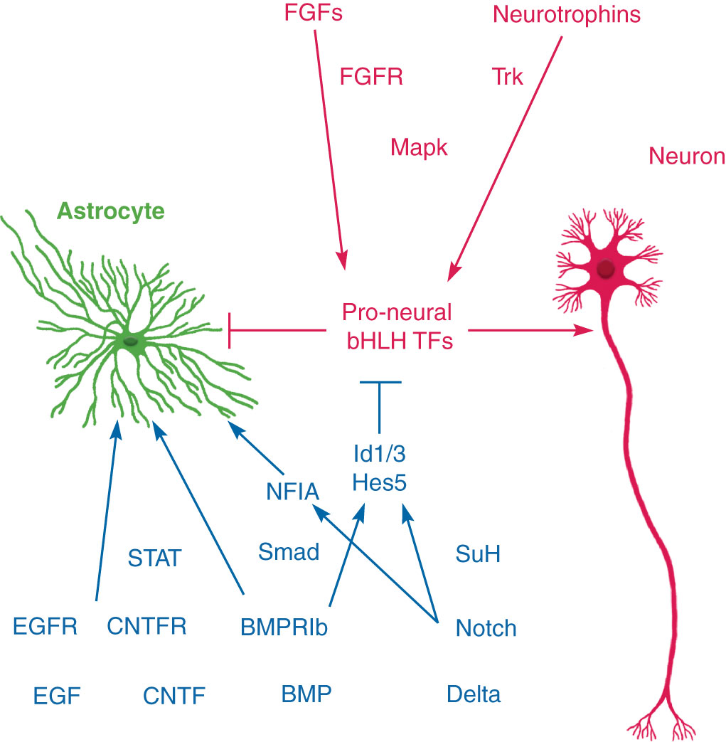
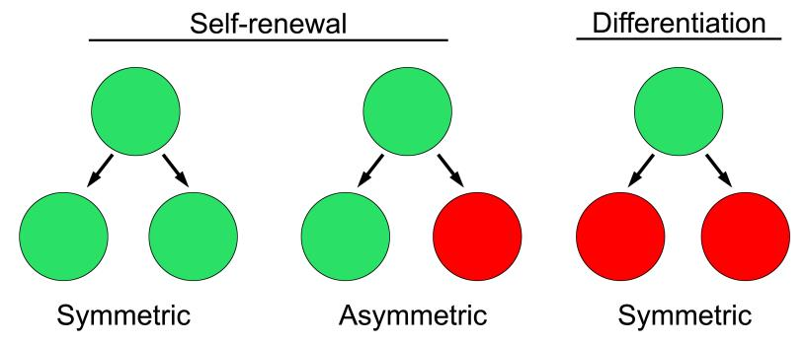
What Factors Control Self-renewal vs Differentiation?

Slide 17
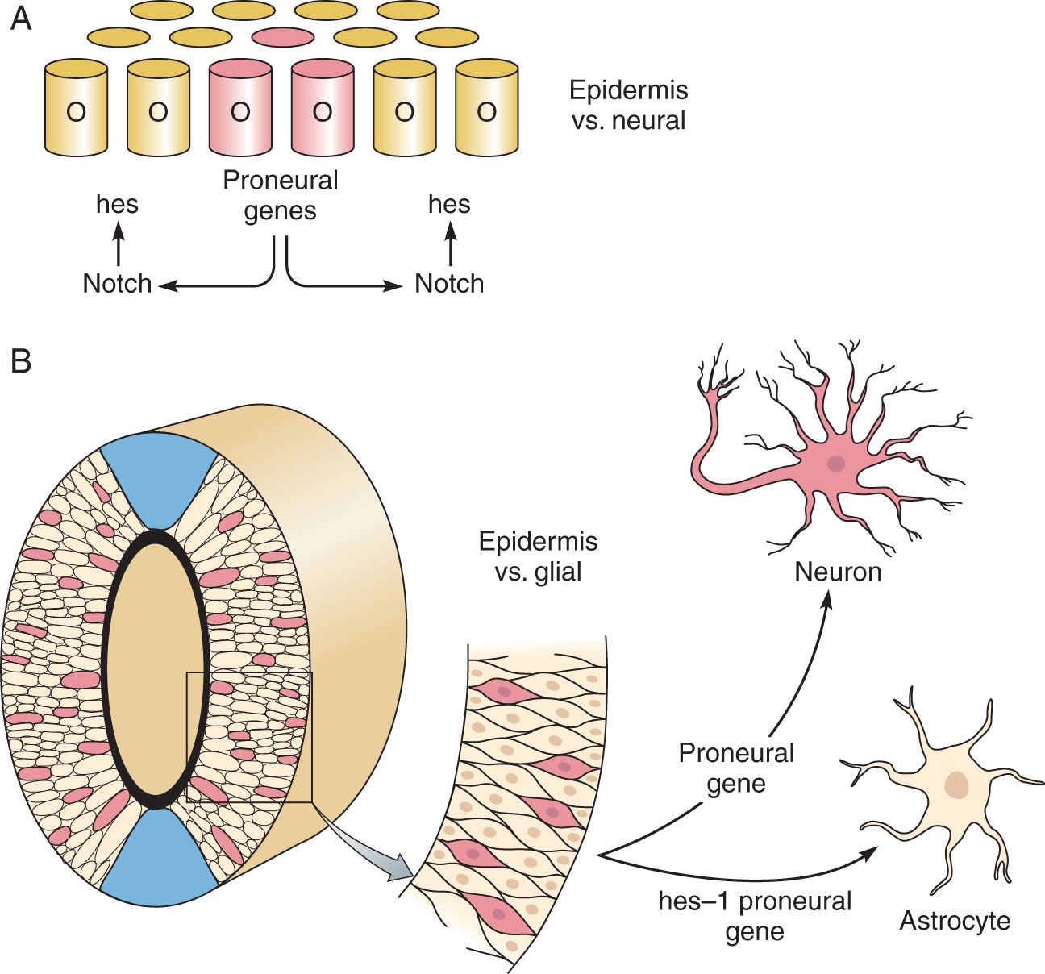
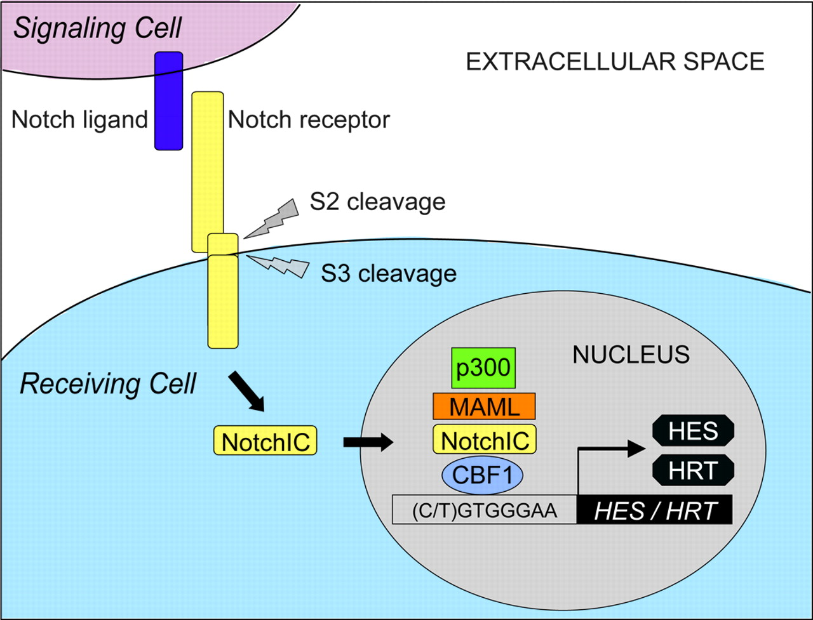
Notch Maintains Stem-ness During Early Development

Slide 18
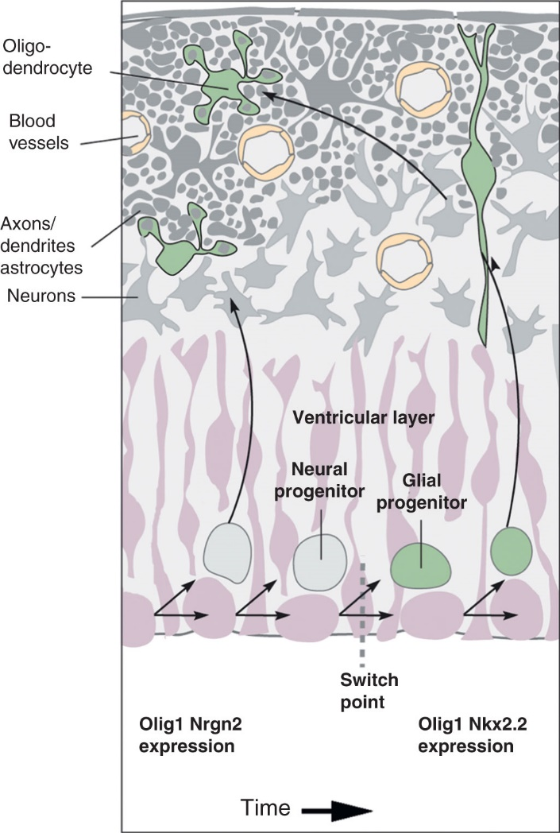
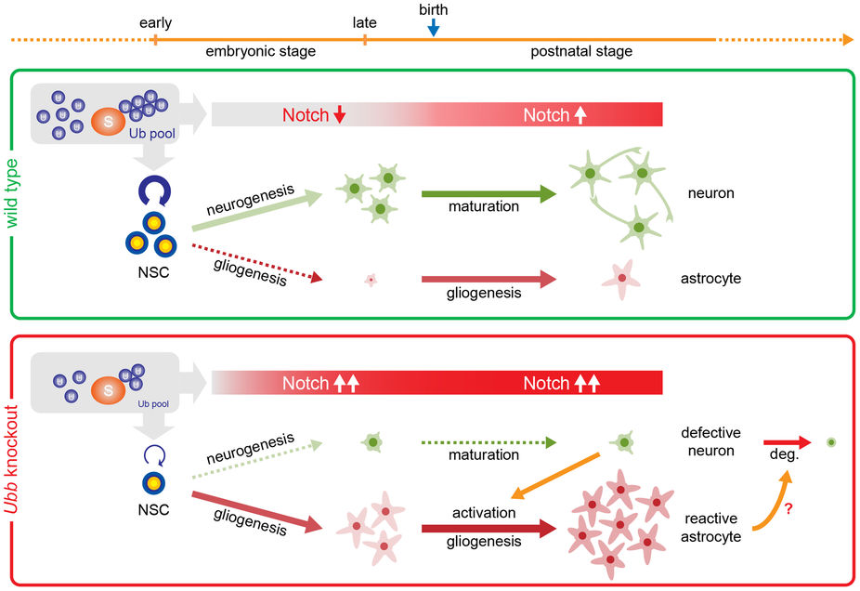
Notch Can Induce Gliogenesis

Slide 19
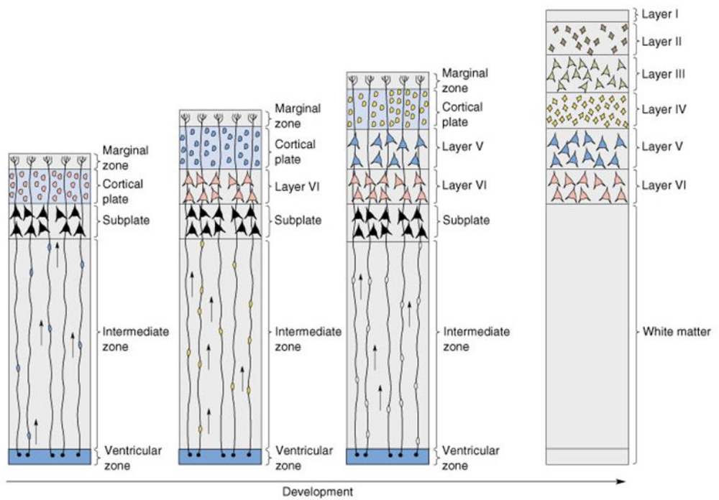
Cortical Development

Slide 20
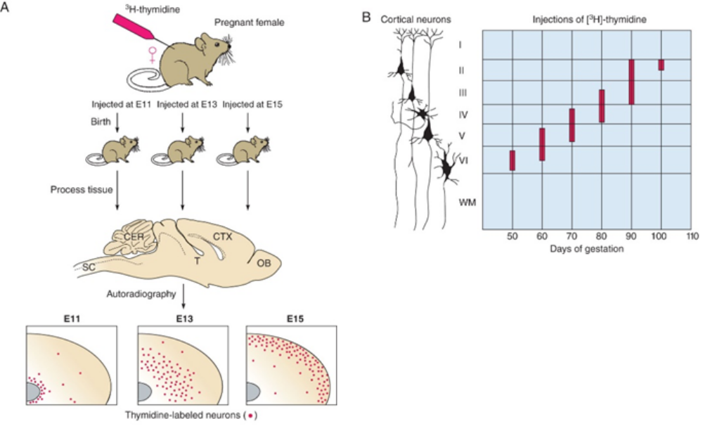
Birthdating Cortical Neurons

Slide 21
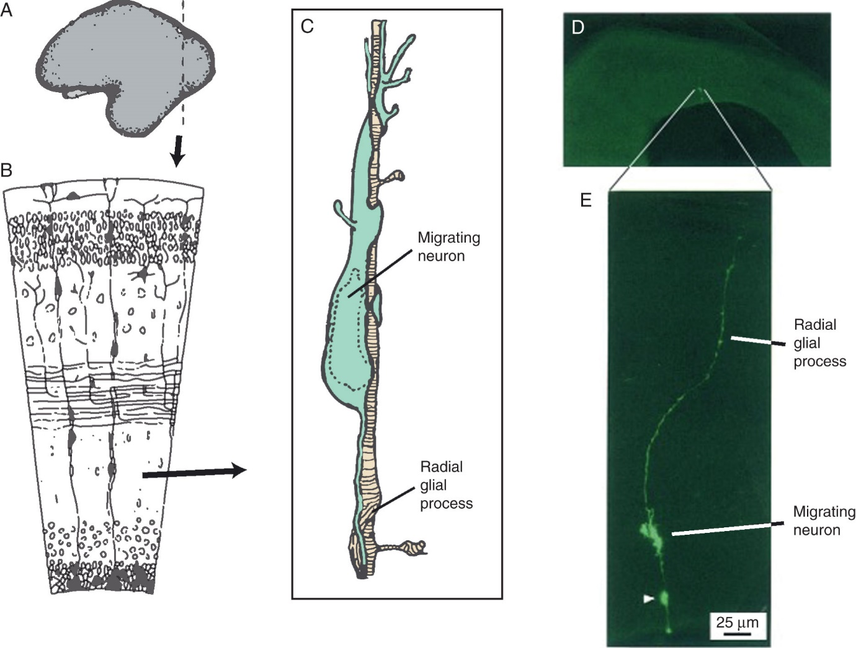
Radial Glia Give Rise to Cortical Columns

Slide 22
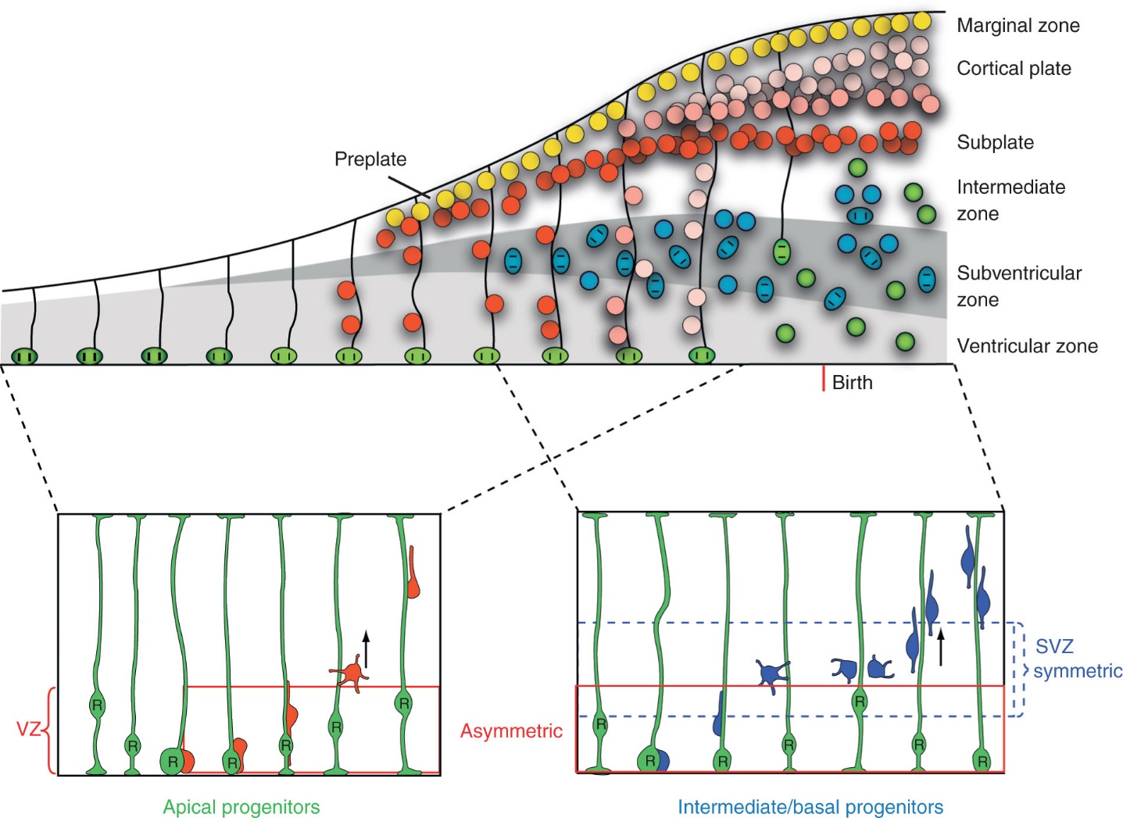
3 Stages of Cortical Neurogenesis
Radial Glia Divide in VZ
Newly born neurons populate preplate
Later cells populate cortical plate

Slide 23
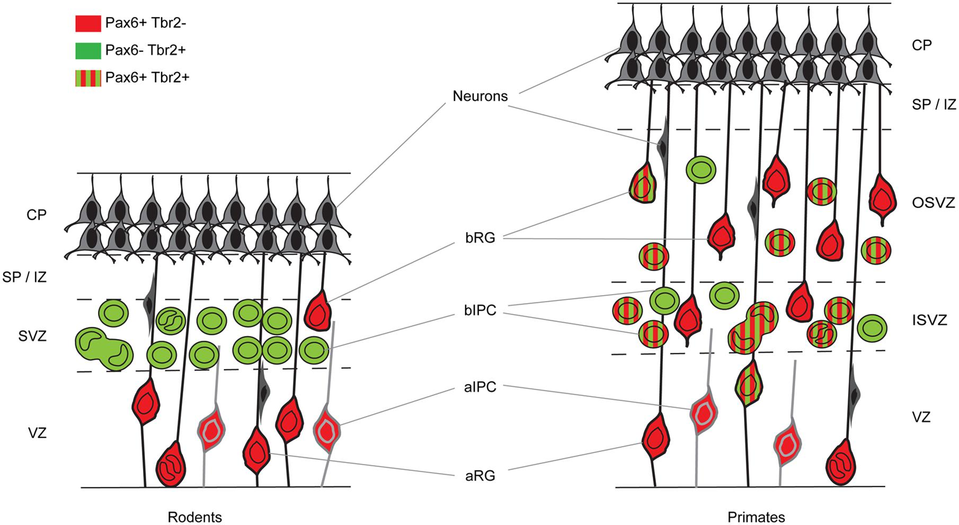
Populations of Dividing Cells in the Cortex
Grey = Tbr1+

Slide 24
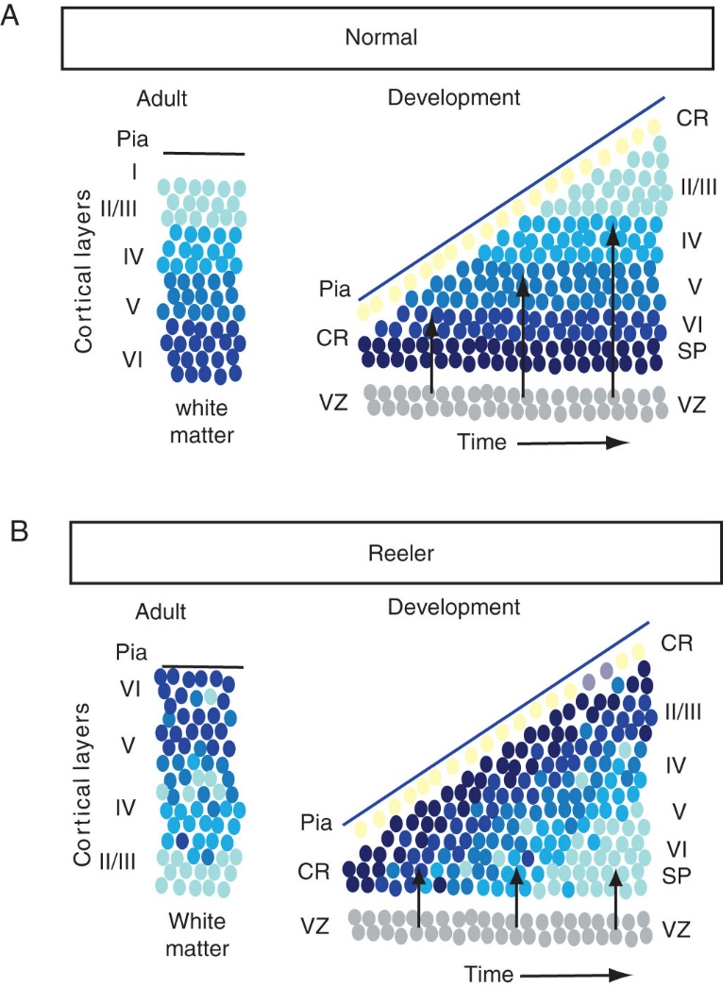
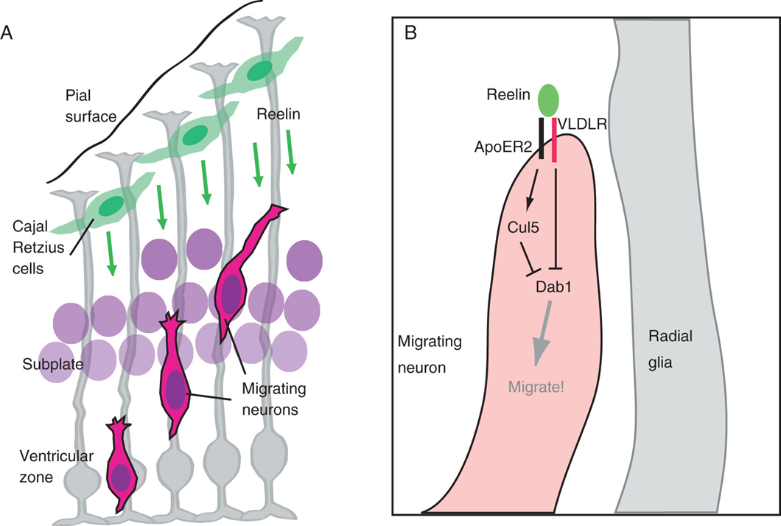
Migration Signaling: Reeling

Slide 25
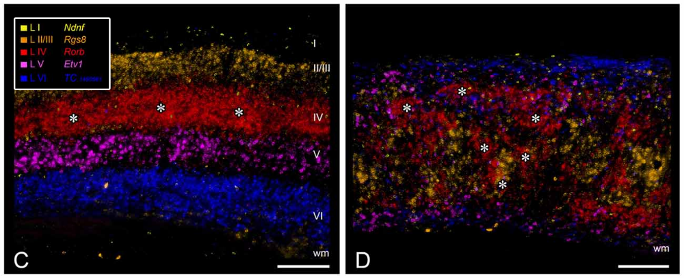
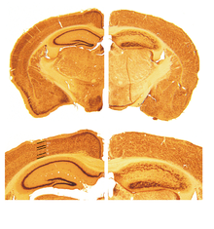
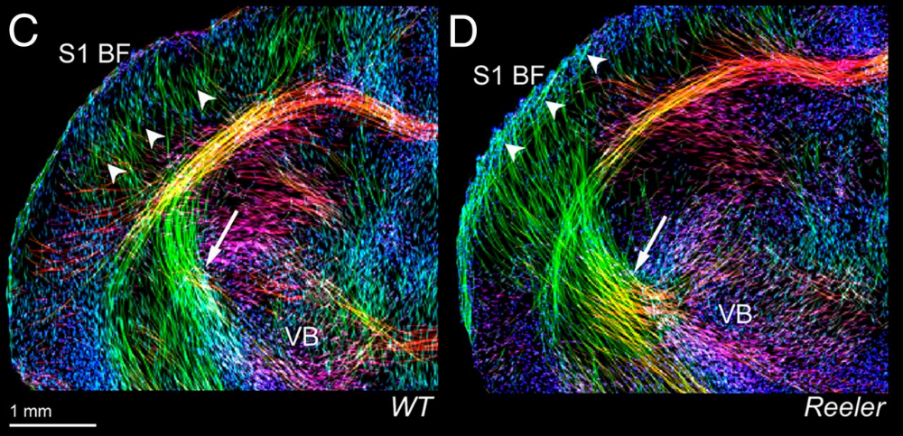
Dislamination leads to rewiringhin the cortex

Slide 26
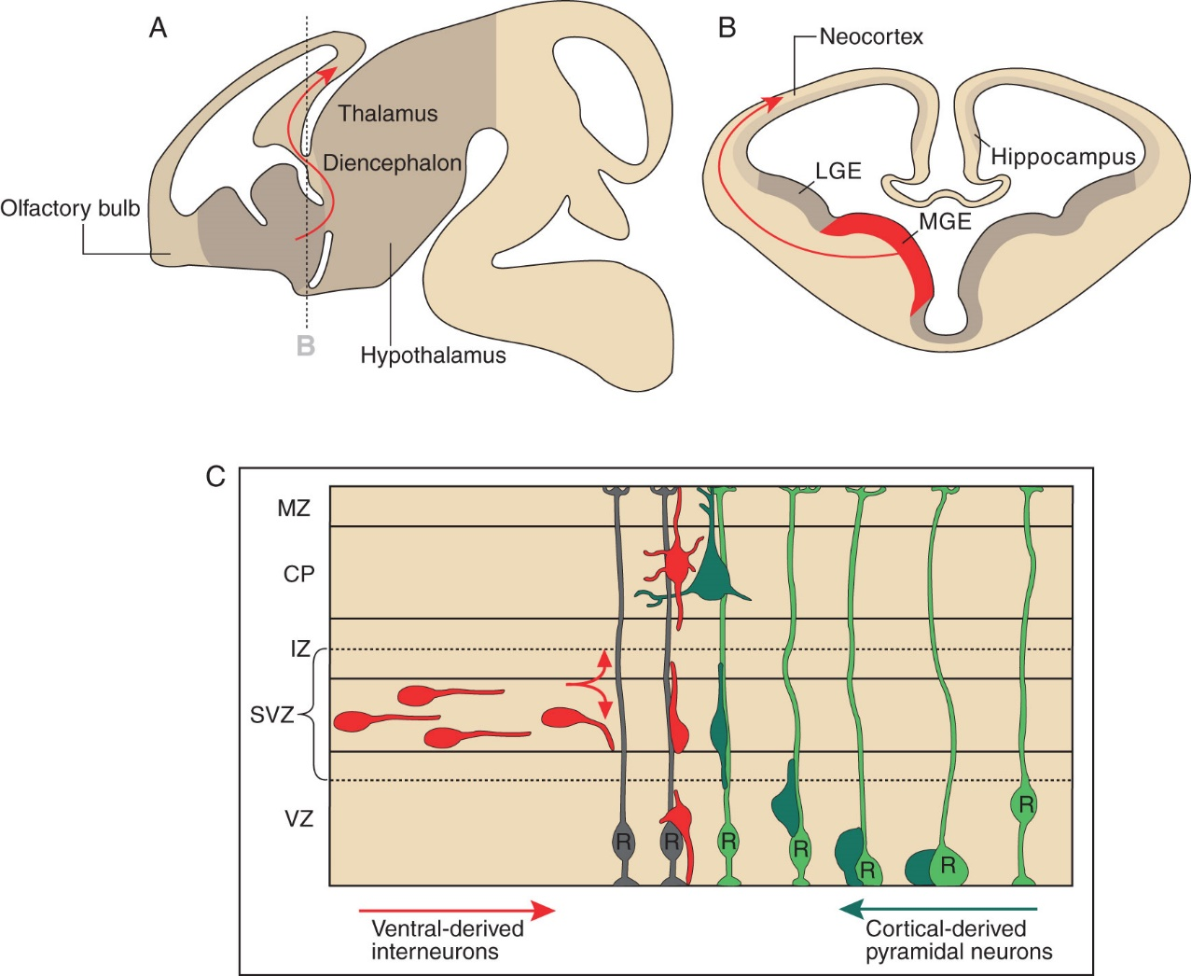
Inhibitory Neurons Migrate Tangentially

Slide 27
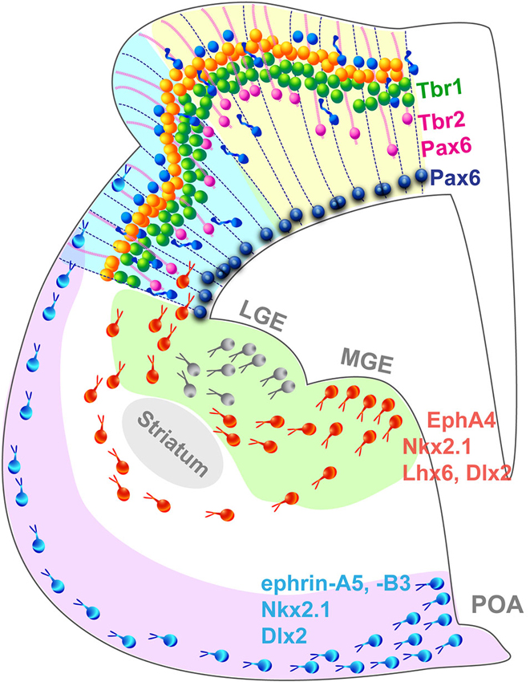
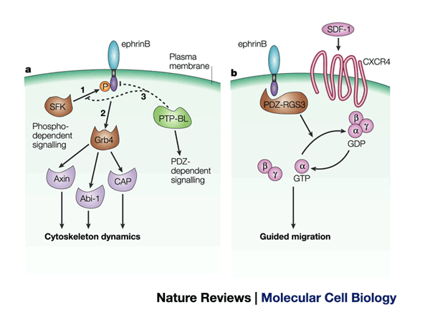
Migration of Interneurons in the Developing Brain

